Slide 1


AUTOMATED IRRIGATION SYSTEM
Malith Imantha - s15423
Harith Ayodhya - s15313
Lakith Navodya - s15432
Durangi Amasha - s15417
Dileka Ratnayaka - s15436
2023.04.27

Slide 2


Overview
Environmental Factors Affecting Soil Moisture and Variables
Soil moisture is a critical environmental factor for plant growth and agricultural productivity. It is affected by several variables such as temperature, humidity, solar radiation, wind speed and precipitation. In our project, we aim to develop an irrigation system that can measure soil moisture and its dependent variables using Arduino and Python.

Slide 3
Introduction
Enhancing Agriculture through Automation and Machine Learning
This project aims to study the correlation between soil moisture and environmental variables
Temperature
Humidity
Solar radiation

Slide 4
Objectives
Building a Smart Irrigation System for Precision Farming
We aim to build a smart irrigation system to predict soil moisture levels based on temperature, humidity, and solar radiation data. We aim to achieve precision farming by controlling the water supply to plants based on their soil moisture needs. Our system will also store the measured and predicted soil moisture data to evaluate the accuracy of the machine-learning model.

Slide 5
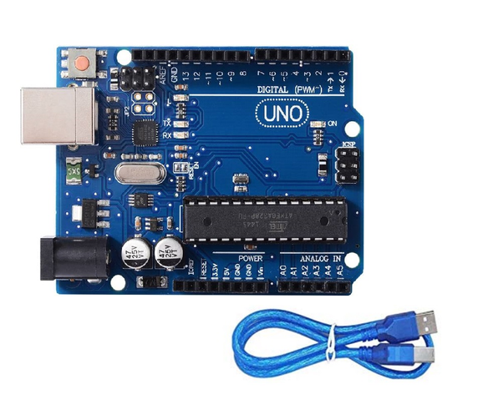
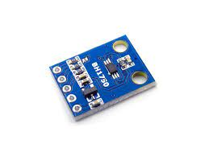
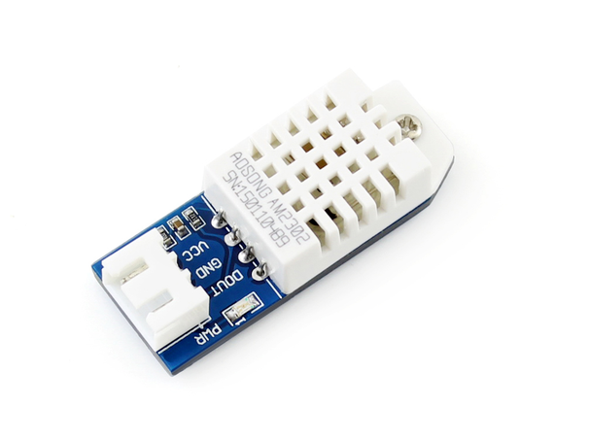
Experimental Procedure
Components and Measurements
Arduino UNO
BH 1750
DHT 220
Light Intensity
Temperature, Humidity

Slide 6

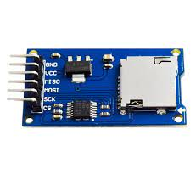
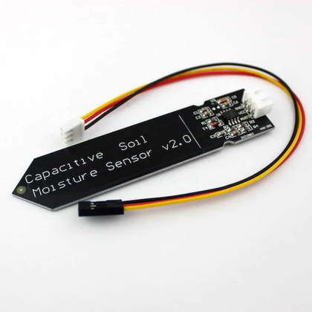
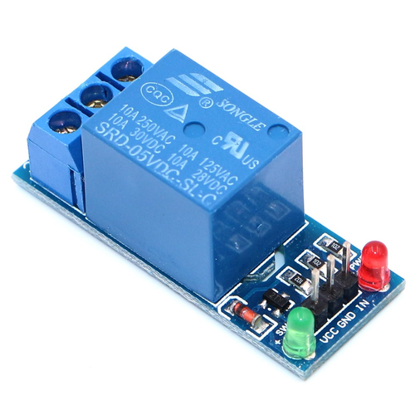
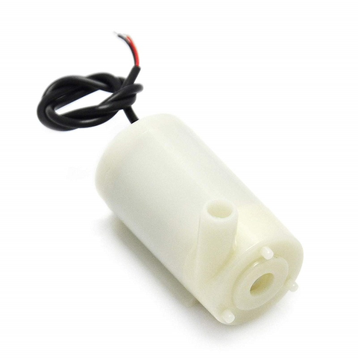
SD Card Module
Store and read data
Experimental Procedure
Components and Measurements
Capacitive Soil Moisture Sensor
Relay
5V DC Motor
Soil moisture
Safety

Slide 7
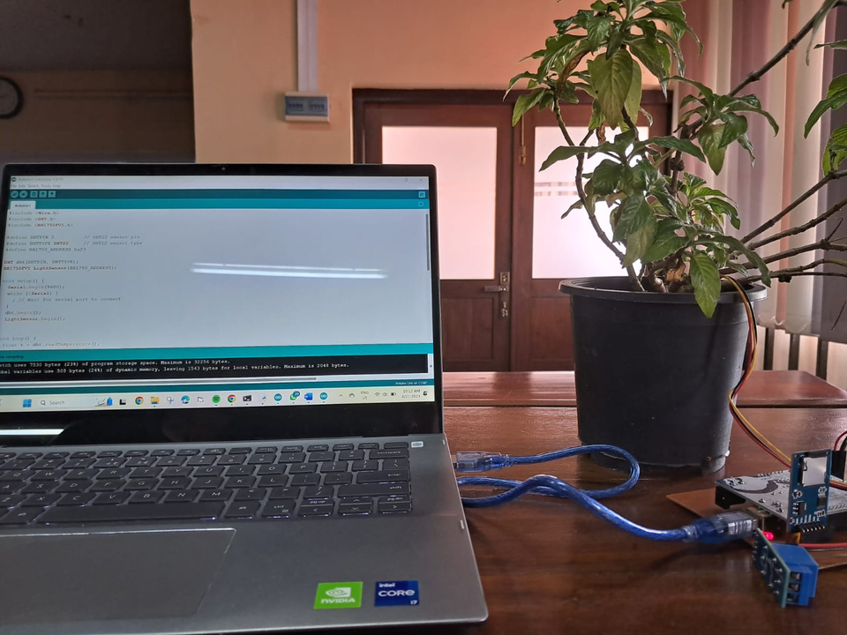
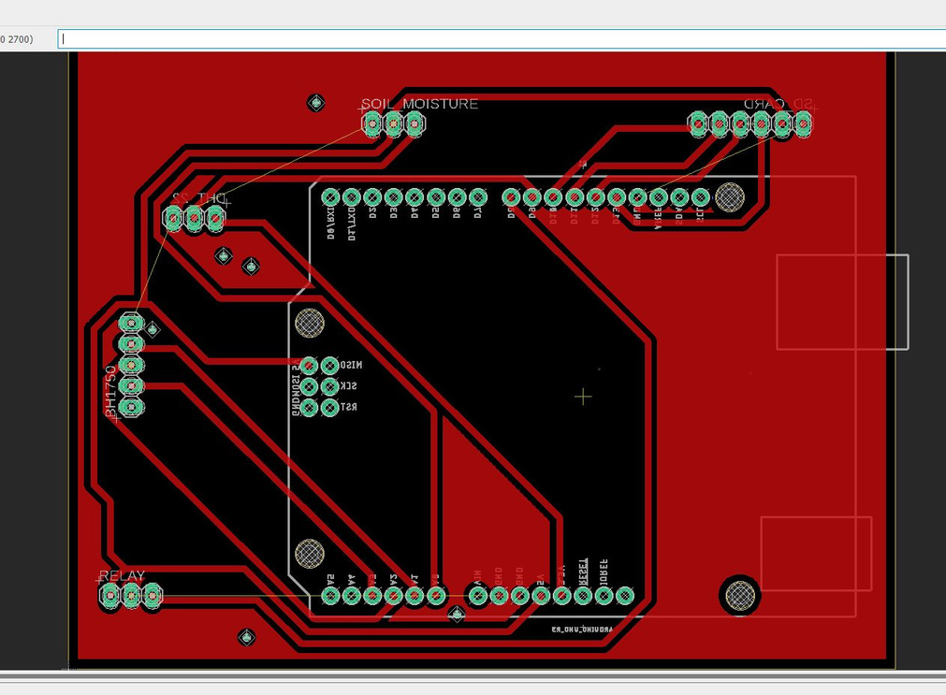
Complete Setup

Slide 8
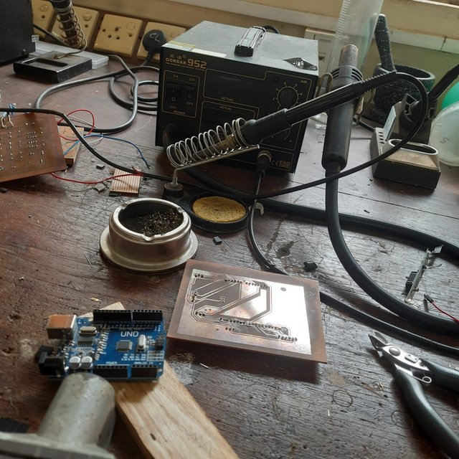
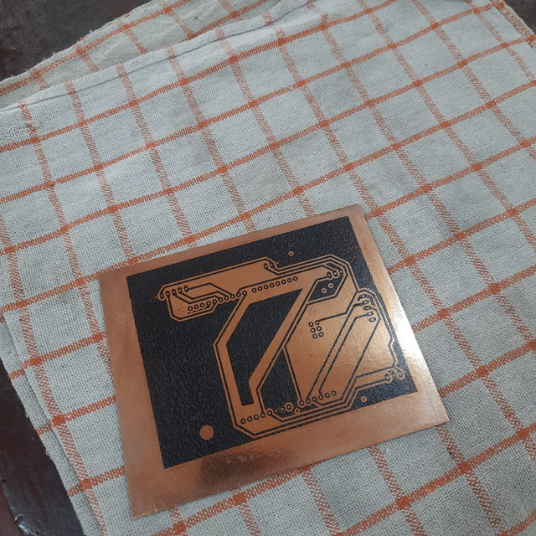
Experimental Procedure
Part 1 - Taking measurements and generating a model
The first part of our project involves the use of an Arduino Uno board, along with several sensors to measure temperature, humidity, solar radiation, and soil moisture. These environmental variables are crucial in understanding how soil moisture varies and how it can be controlled for optimal plant growth. By collecting data from the sensors and analyzing it using Python, we can build a machine learning model that will help us predict soil moisture levels based on the other environmental factors. This model will be used in the second part of our project, where we will use it to control a water pump and maintain optimal soil moisture levels.

Slide 9
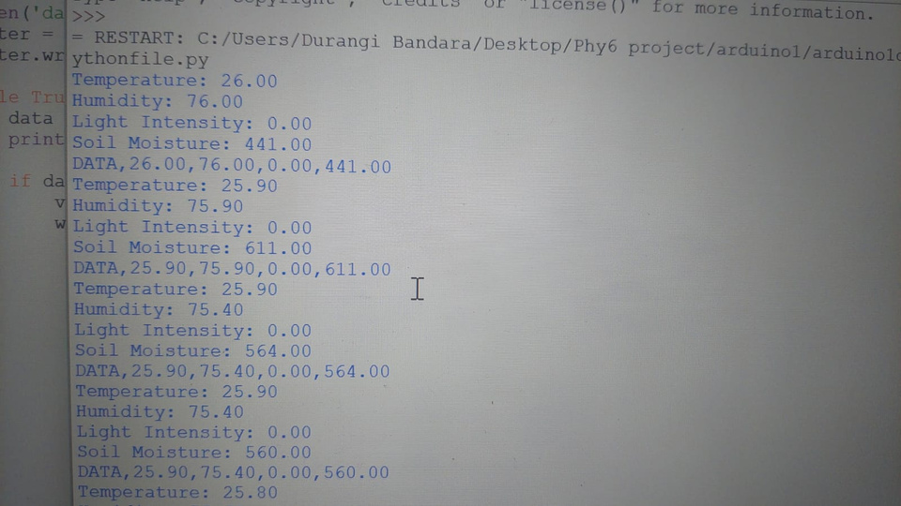
Experimental Procedure
Part 2 - Real-time Data Processing
In the second part of the project, we will directly take input from the sensors and process the data using Arduino. We will use the machine learning model developed in the first part to predict soil moisture levels based on real-time temperature, humidity, and solar radiation data. When the predicted soil moisture level is below a predetermined threshold, the DC water pump connected to the Arduino board will start working. Once the soil moisture level increases to the desired level, the motor will stop working.

Slide 10
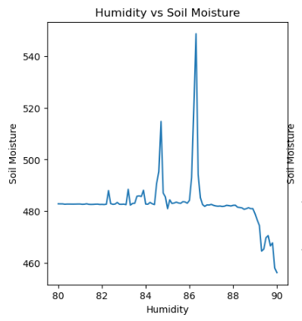
Results and Analysis
We will store the measured and predicted soil moisture data and compare them to evaluate the accuracy of the machine-learning model. We will use performance metrics such as mean absolute error and root mean square error to assess the accuracy of the model.

Slide 11
Summary
Experimental apparetus
Data set 1
Sensor readings
150K+
Graphs
Data Predictions
Motor
Error Analysis
Market Size

Slide 12
Conclusion
The conclusion of this project is that we have successfully developed an irrigation system using Arduino and Python, which can predict soil moisture based on temperature, humidity, and solar radiation values. We have achieved this by developing a machine learning model using Python and trained it with the data collected from various sensors connected to the Arduino board. This system can be used to automatically water plants and crops, and it can be controlled remotely. Additionally, we have identified the errors in the model by comparing the predicted values with the actual values measured by the sensors, and we can improve the accuracy of the system by fine-tuning the machine learning model. Overall, this system can be useful for farmers and gardeners who want to optimize their irrigation process and conserve water resources.

Slide 13
Future directions
In the future, we plan to implement time-series prediction based on our developed model, which will enable us to forecast soil moisture levels. By utilizing such predictions, we can detect any potential threats to the crop and use the irrigation system more efficiently. Furthermore, we may incorporate additional environmental variables, such as wind speed, rainfall, and atmospheric pressure, to enhance the accuracy of our prediction model.

Slide 14
THANK YOU!
2023.04.27

